Slide 1
St. George’s Central CE Primary School and Nursery
Y2BR
Miss Ranger and Mrs Westlake
Tuesday 6th September 2022
‘Never settle for less than your best’

Slide 2
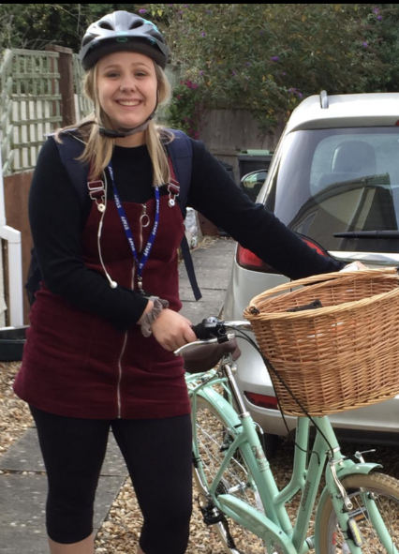
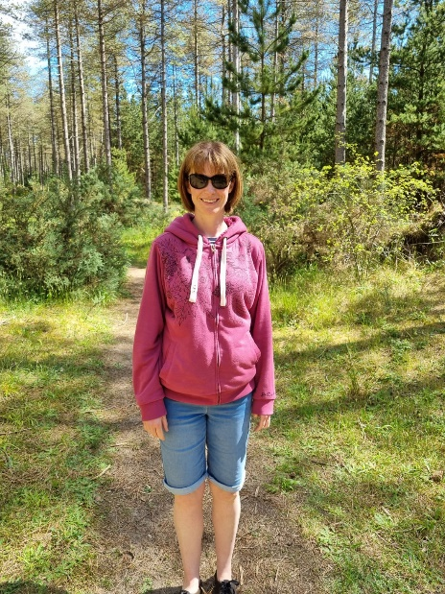
St. George’s Central CE Primary School and Nursery
Who are we?
Miss Ranger
I am going into my 4th year of teaching and have experience in a variety of year groups, primarily Year 3. I am originally from Bournemouth but moved to the area last September. I love being outdoors and exploring the world around me.
Mrs Westlake
I am new to working in a school and this class will be my first which is very exciting. I love to spend time with my family and enjoy being by the sea and camping.
‘Never settle for less than your best’

Slide 3
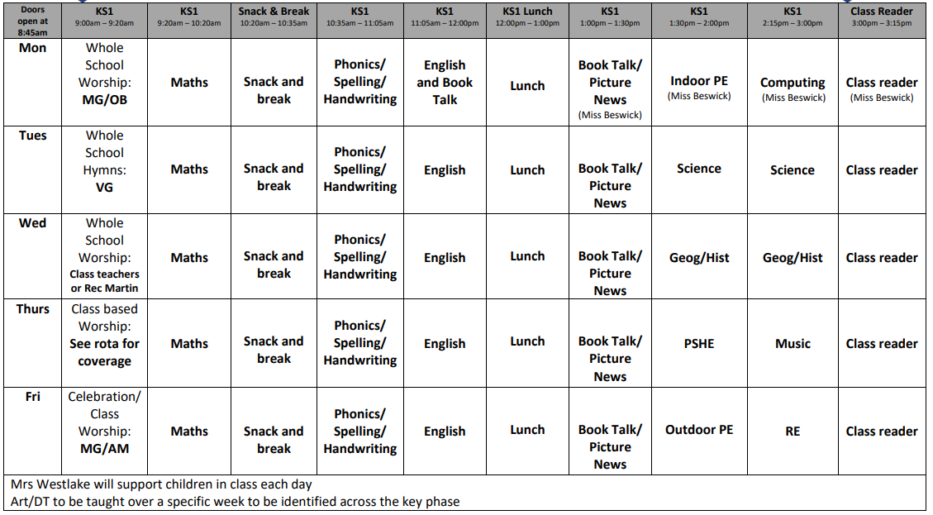
St. George’s Central CE Primary School and Nursery
‘Never settle for less than your best’

Slide 4
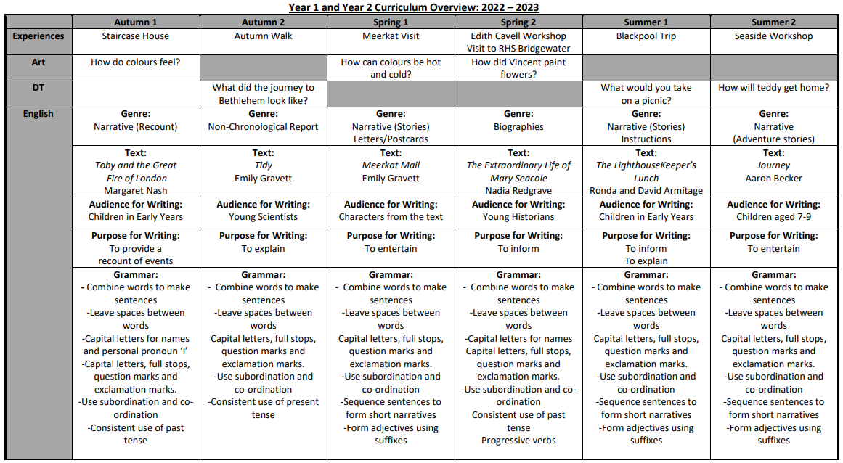
St. George’s Central CE Primary School and Nursery
‘Never settle for less than your best’

Slide 5
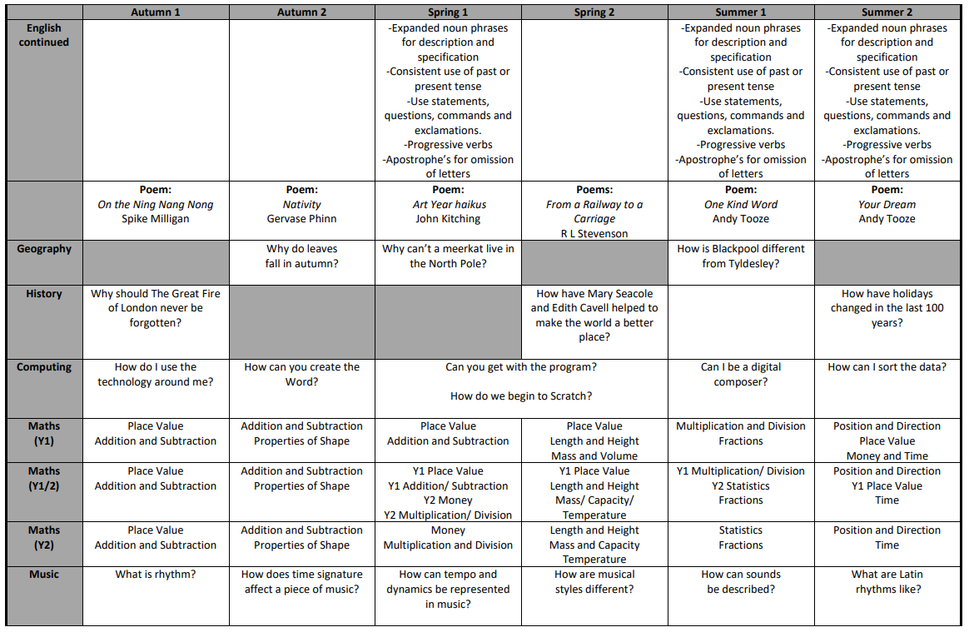
St. George’s Central CE Primary School and Nursery
‘Never settle for less than your best’

Slide 6
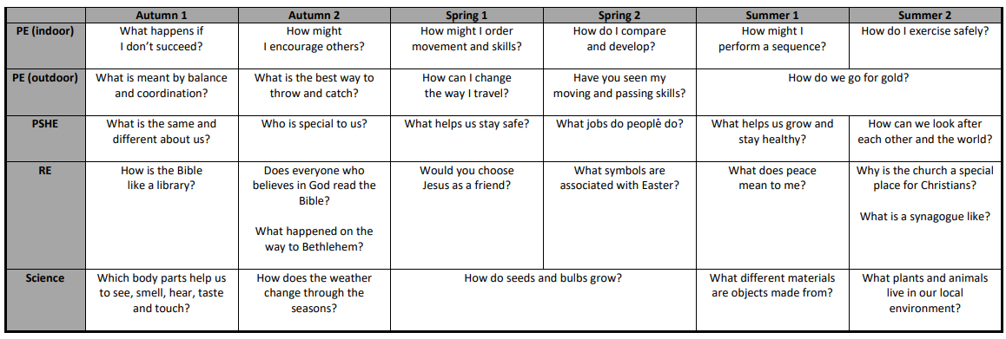
St. George’s Central CE Primary School and Nursery
‘Never settle for less than your best’

Slide 7

St. George’s Central CE Primary School and Nursery
‘Never settle for less than your best’

Slide 8
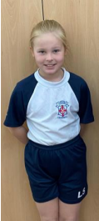
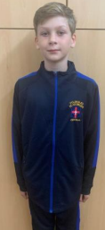
St. George’s Central CE Primary School and Nursery
PE
Our PE days are Monday (Indoor) and Friday (Outdoor).
On Mondays, children should come dressed in their indoor PE kit and trainers – their pumps will be kept at school.
On Fridays, children should come dressed in their outdoor PE kit.
‘Never settle for less than your best’

Slide 9
St. George’s Central CE Primary School and Nursery
Online Safety
Keeping children active is important and this should be encourages. Time spent on a screen should be minimal.
We live in an ever-changing world, especially when it comes to technology. Whilst the internet is an excellent resource, it is important that we educate children on how to use it safely.
Check out https://www.saferinternet.org.uk for more information.
‘Never settle for less than your best’

Slide 10






St. George’s Central CE Primary School and Nursery
Our main texts this year
‘Never settle for less than your best’

Slide 11

St. George’s Central CE Primary School and Nursery
‘Never settle for less than your best’

Slide 12
St. George’s Central CE Primary School and Nursery
Why is reading important?
*Builds vocabulary and understanding of the world
*Improves focus and concentration
*Develops imagination – creative story tellers and writers!
*It improves peoples perceptions of you
*Reduce stress
*Improves memory
*Supports ability to access tests
*It is actually fun!
‘Never settle for less than your best’

Slide 13
St. George’s Central CE Primary School and Nursery
What can you do?
*Quality time between yourself and your child. Make time to listen to your child read and time for them to listen to you read. This should not be a chore.
*Remove any distractions. Turn off the television and read in a quite area.
*Bring the book to life. Explore different voices!
*Emphasise repeated words. Find tricky words.
*Talk about the book, story, characters, illustrations. Ask your child questions about what they have read – why, how, when, where?
*Short sharp bursts. Quality not quantity.
‘Never settle for less than your best’

Slide 14
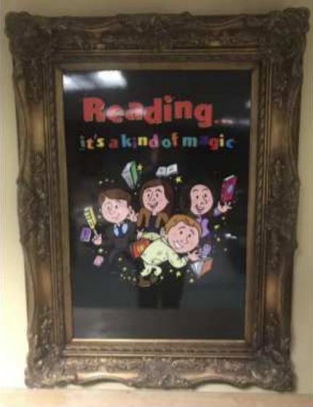

St. George’s Central CE Primary School and Nursery
What can you do?
Reading Expectations
*Reading 3 times per week at home. Please write a comment and sign your child’s planner.
*Access Reading Eggs every week.
‘Never settle for less than your best’

Slide 15

St. George’s Central CE Primary School and Nursery
Home Learning
*Home Learning will be sent home in your child’s planner.
*This will be set on a Friday and due in the following Friday.
*Spellings, Beat That Big Maths, Reading
*Spellings will be tested on the following Friday.
*Communication will be made via Seesaw, please check regularly.
https://www.saintgeorgescentral.wigan.sch.uk/Classes2BR.html
‘Never settle for less than your best’

Slide 16
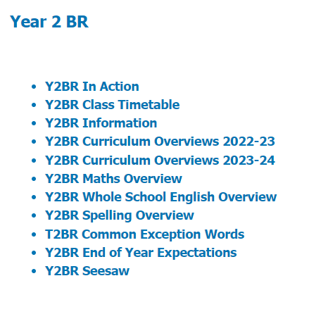
St. George’s Central CE Primary School and Nursery
Overview
PE days – Monday (indoor) and Friday (outdoor) – Please come in PE kit.
Reading at least 3 times a week.
Homework is set on Friday to be returned the following Friday.
Class twitter and Seesaw on class page.
https://www.saintgeorgescentral.wigan.sch.uk/Classes2BR.html
‘Never settle for less than your best’

